Slide 1
Map-Reduce Streaming API
Péter Molnár
Institute for Insight
J. Mack Robinson College of Business
Georgia State University

Slide 2
Examples
Word Count
Twitter ETL
Collating, Sorting, Filtering
Join Tables
Naïve Bayes

Slide 3
HDFS + MapReduce
map(key1,value) -> list<key2,value2>
reduce(key2, list<value2>) -> list<value3>

Slide 5
Usage:
$HADOOP_PREFIX/bin/hadoop jar hadoop-streaming.jar [options]Options:
-input
<path> DFS input file(s) for the Map step.
-output
<path> DFS output directory for the Reduce step.
-mapper
<cmd|JavaClassName> Optional. Command to be run as mapper.
-combiner
<cmd|JavaClassName> Optional. Command to be run as combiner.
-reducer
<cmd|JavaClassName> Optional. Command to be run as reducer.

Slide 6


Slide 7
Sandbox Setup
Connecting
Create user account, make yourself sudoer
useradd -m -c "Max Headway" mheadway
passwd mheadway
vi /etc/group
SSH/SCP password-less access
Install additional packages on the sandbox
sudo yum install R

Slide 8
Cluster Login/Transfer Data
ssh/scp
Putty/WinSCP
FileZilla

Slide 9
Navigate HDFS
General Commands
hdfs dfs -usage
hdfs dfs -ls /
hdfs dfs –mkdir –p /home/mheadway
alias hls='hdfs dfs -ls $*'

Slide 10
Map-Reduce Streaming API
$ yarn jar /usr/hdp/current/hadoop-mapreduce-client/hadoop-streaming.jar \
-input /demo/data/Website/Website-Logs/* \
-output /home/pmolnar/streamout \
-mapper /bin/cat \
-reducer /bin/cat \
-numReduceTasks 2
$ yarn jar /usr/hdp/current/hadoop-mapreduce-client/hadoop-streaming.jar \
-info
$ export HSTREAMING="$HADOOP_PREFIX/bin/hadoop jar hadoop-streaming.jar"

Slide 11
Examples
Word Count
Twitter ETL
Collating, Sorting, Filtering
Join Tables
Naïve Bayes

Slide 12
Word Count
Mapper: Extract words from documents, create a single stream of (word, 1) tuples
Reducer: Count individual words … they come in order. Emit (word, N) when the next word is read.

Slide 13
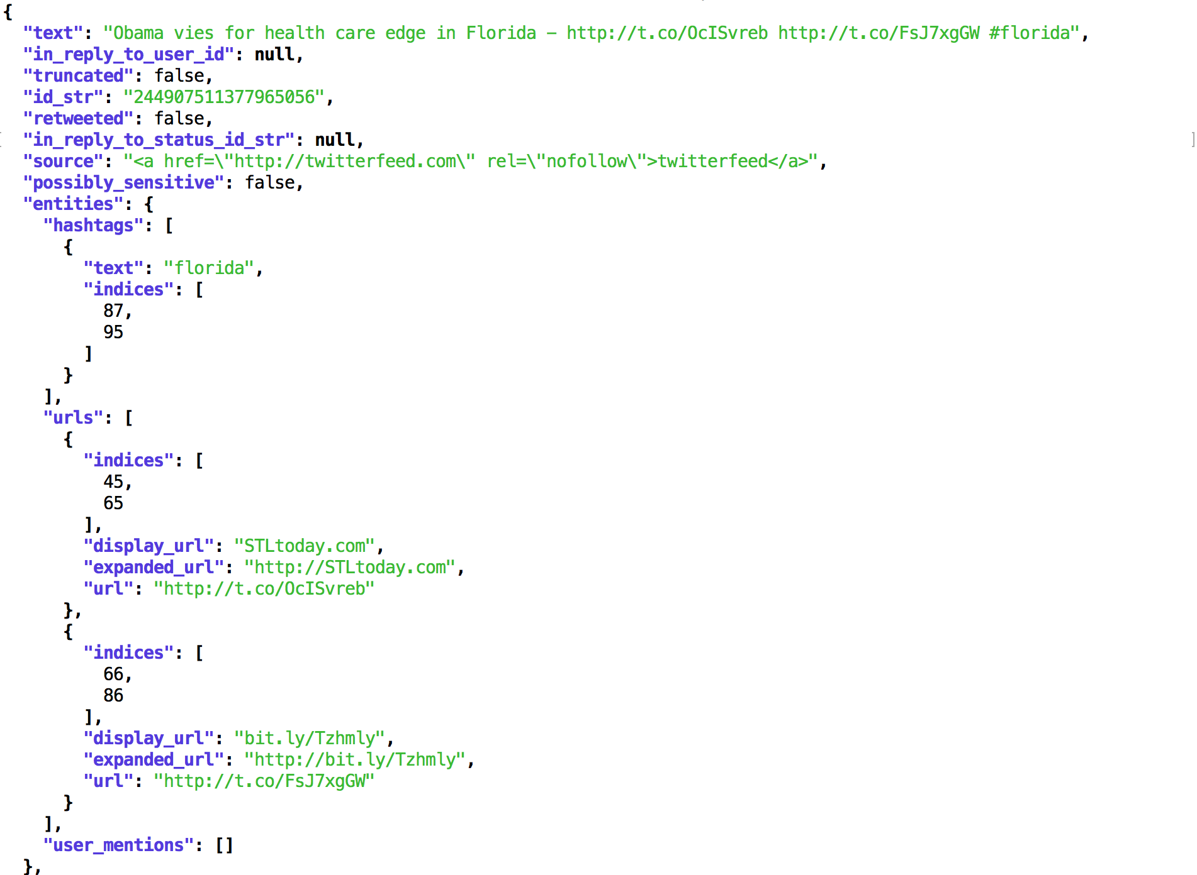
Twitter ETL
https://datahub.io/dataset/twitter-2012-presidential-election

Slide 14
Collating
Problem Statement: There is a set of items and some function of one item. It is required to save all items that have the same value of function into one file or perform some other computation that requires all such items to be processed as a group. The most typical example is building of inverted indexes.
Solution:
The solution is straightforward. Mapper computes a given function for each item and emits value of the function as a key and item itself as a value. Reducer obtains all items grouped by function value and process or save them. In case of inverted indexes, items are terms (words) and function is a document ID where the term was found.

Slide 15
Filtering (“Grepping”), Parsing, and Validation
Problem Statement: There is a set of records and it is required to collect all records that meet some condition or transform each record (independently from other records) into another representation. The later case includes such tasks as text parsing and value extraction, conversion from one format to another.
Solution: Solution is absolutely straightforward – Mapper takes records one by one and emits accepted items or their transformed versions.

Slide 16
Sorting
Problem Statement: There is a set of records and it is required to sort these records by some rule or process these records in a certain order.
Solution: Simple sorting is absolutely straightforward – Mappers just emit all items as values associated with the sorting keys that are assembled as function of items. Nevertheless, in practice sorting is often used in a quite tricky way, that’s why it is said to be a heart of MapReduce (and Hadoop). In particular, it is very common to use composite keys to achieve secondary sorting and grouping.

Slide 17
Joining
This algorithm joins of two sets R and L on some key k. Mapper goes through all tuples from R and L, extracts key k from the tuples, marks tuple with a tag that indicates a set this tuple came from (‘R’ or ‘L’), and emits tagged tuple using k as a key. Reducer receives all tuples for a particular key k and put them into two buckets – for R and for L. When two buckets are filled, Reducer runs nested loop over them and emits a cross join of the buckets. Each emitted tuple is a concatenation R-tuple, L-tuple, and key k. This approach has the following disadvantages:
Mapper emits absolutely all data, even for keys that occur only in one set and have no pair in the other.
Reducer should hold all data for one key in the memory. If data doesn’t fit the memory, its Reducer’s responsibility to handle this by some kind of swap.

Slide 18
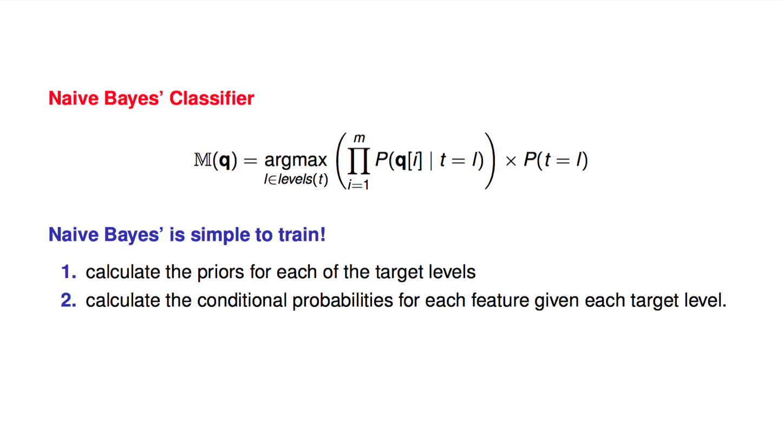

Slide 19
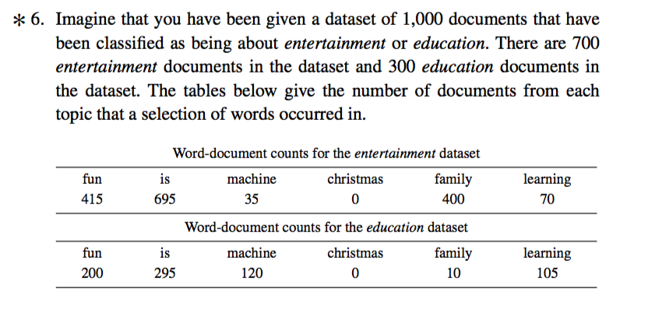
…basically counting

Slide 20
